Slide 1
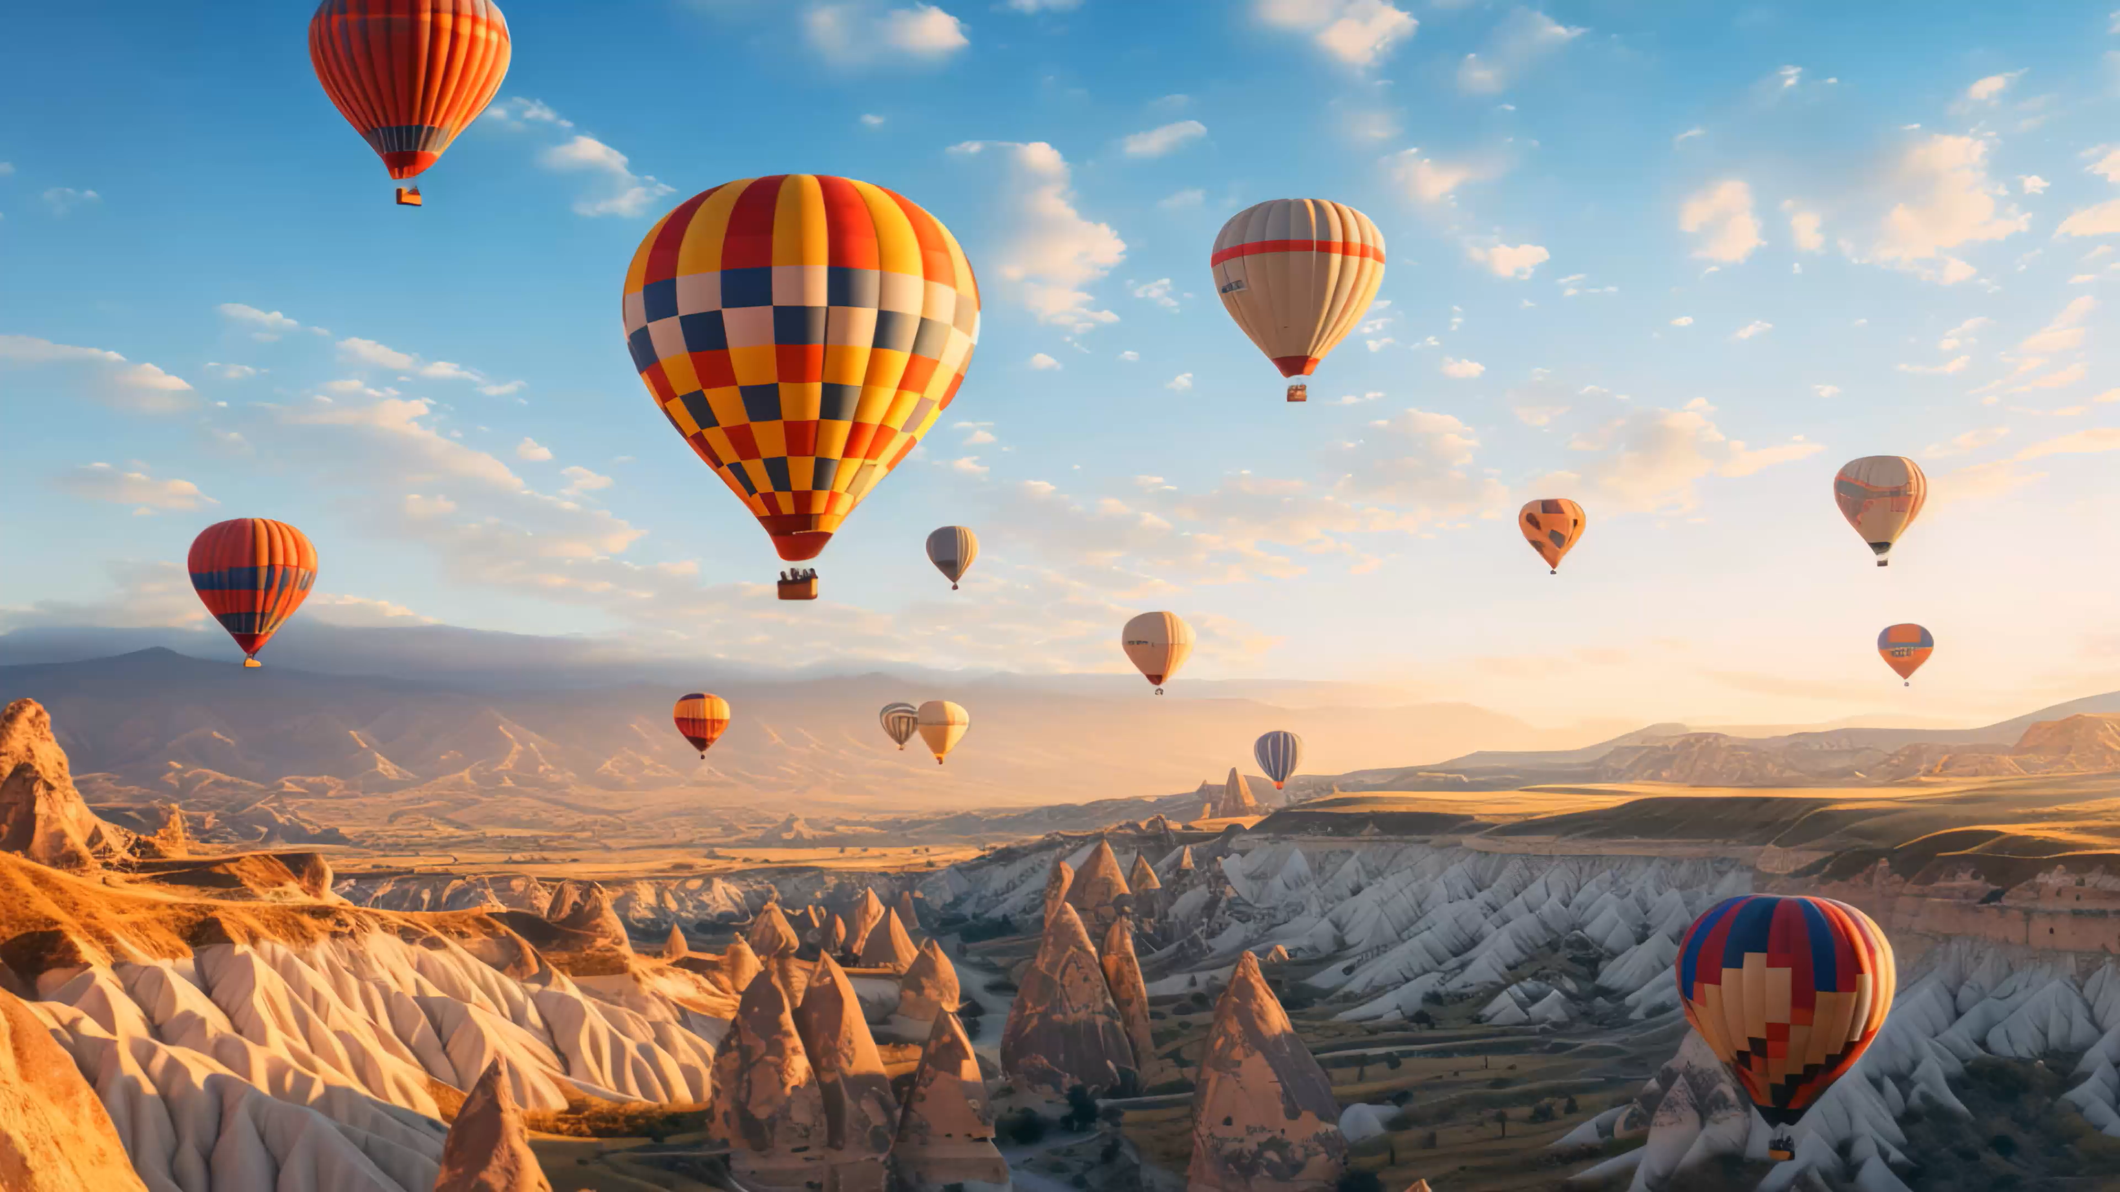
AERIS CAVE RESORT
PRESENTED BY:
Hooriya Sohail
Tayyaba Sohail
Mahnoor Asmat
Amna Arshad
Duaa Zehra
Azbah Naveed
PRESENTED TO:
Miss Ramsha Khalid

Slide 2
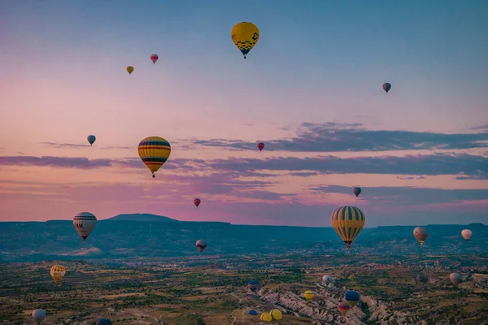
ABOUT
This power-point overviews a website that explores our hotel resort, Aeris Cave Resort, situated in Cappadocia, Turkey. It details the resort infrastructure and accommodation facilities, offered packages and activities, followed by a booking and contact information page.

Slide 3


OBJECTIVES/CONTENTS
OBJECTIVES
LAYOUT OF THE WEBSITE:
Navigation bar
Hero-page layout
Packages (listing featured packages)
Accommodation
Activities and experiences
Contact and booking
DATA FROM EXCEL:
Packages booked
Rooms booked
Revenue-generated
LINKS:
Demonstrational Video
GITHUB URL
DESIGN DESCRIPTIONS
REFLECTION AND PROGRESSION

Slide 4

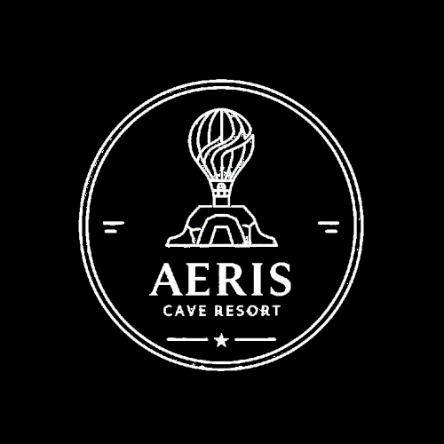
BRAND IMMERSION
Figure 1.0: Resort Logo

Slide 5
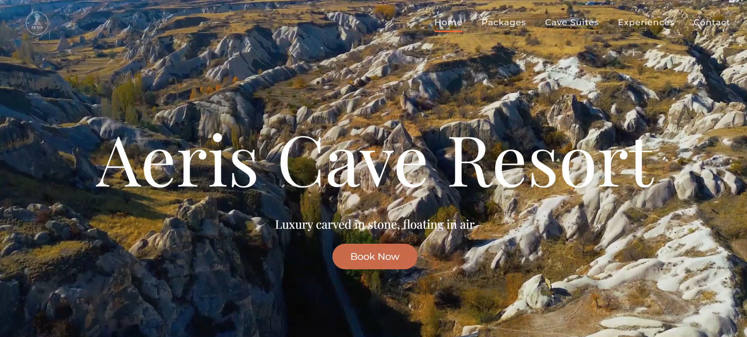
HERO-PAGE

Slide 6

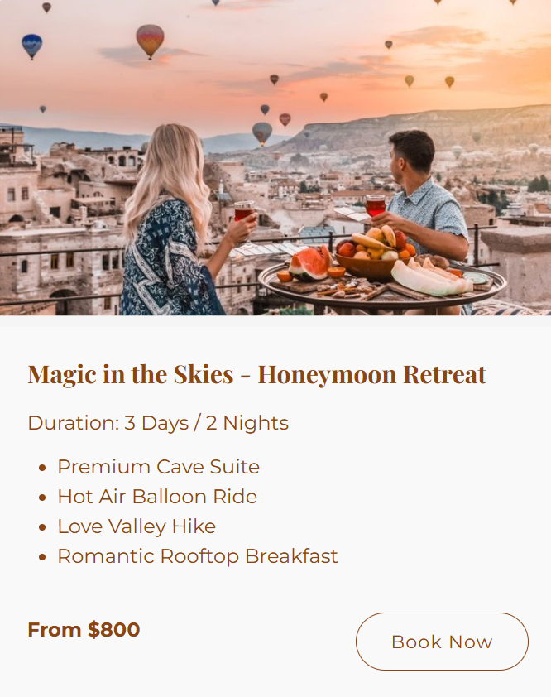
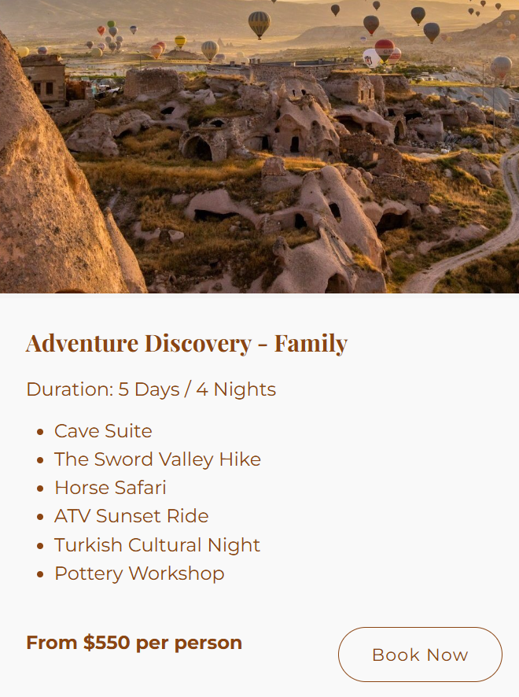
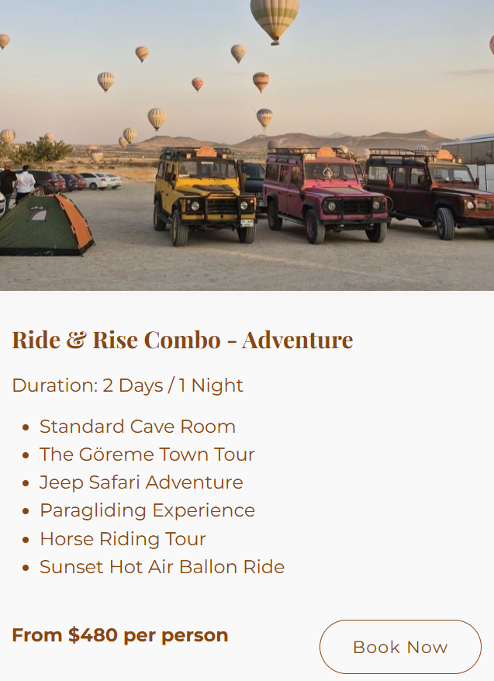
PACKAGES
This webpage displays the different resort packages available. Users can view and select package details, pricing, and choose the option that best suits their needs.
Figure 1.1
Figure 1.2
Figure 1.3

Slide 7

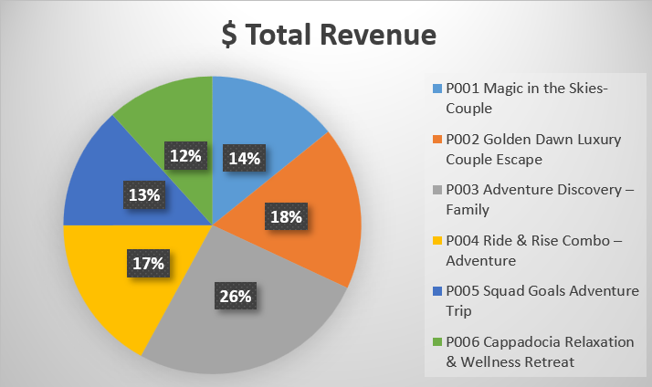
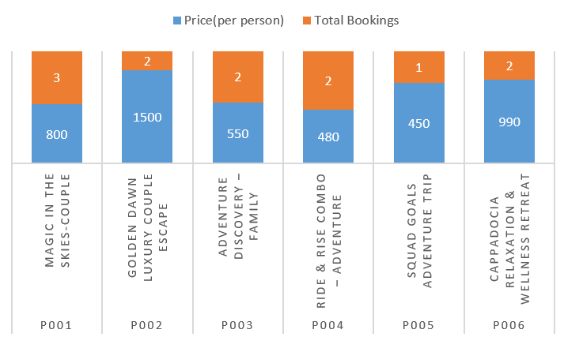
STATISTICAL DATA ON PACKAGES
Figure 1.4: Exported from Excel
Figure 1.5: Exported from Excel

Slide 8
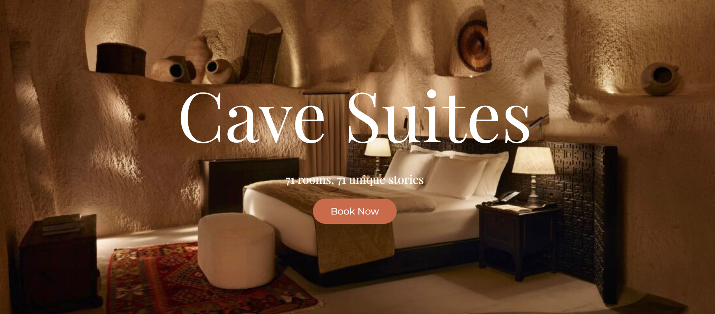

Slide 9
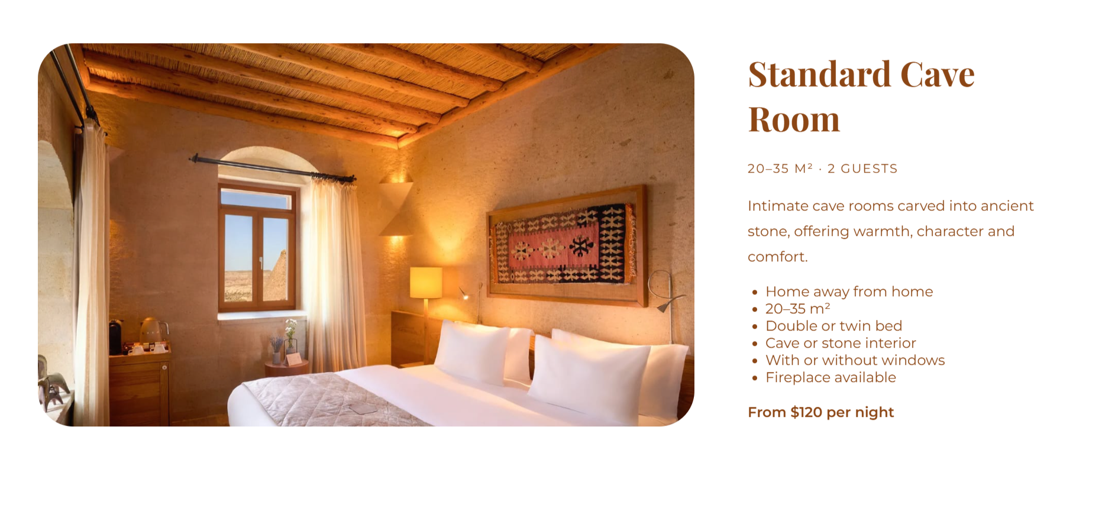
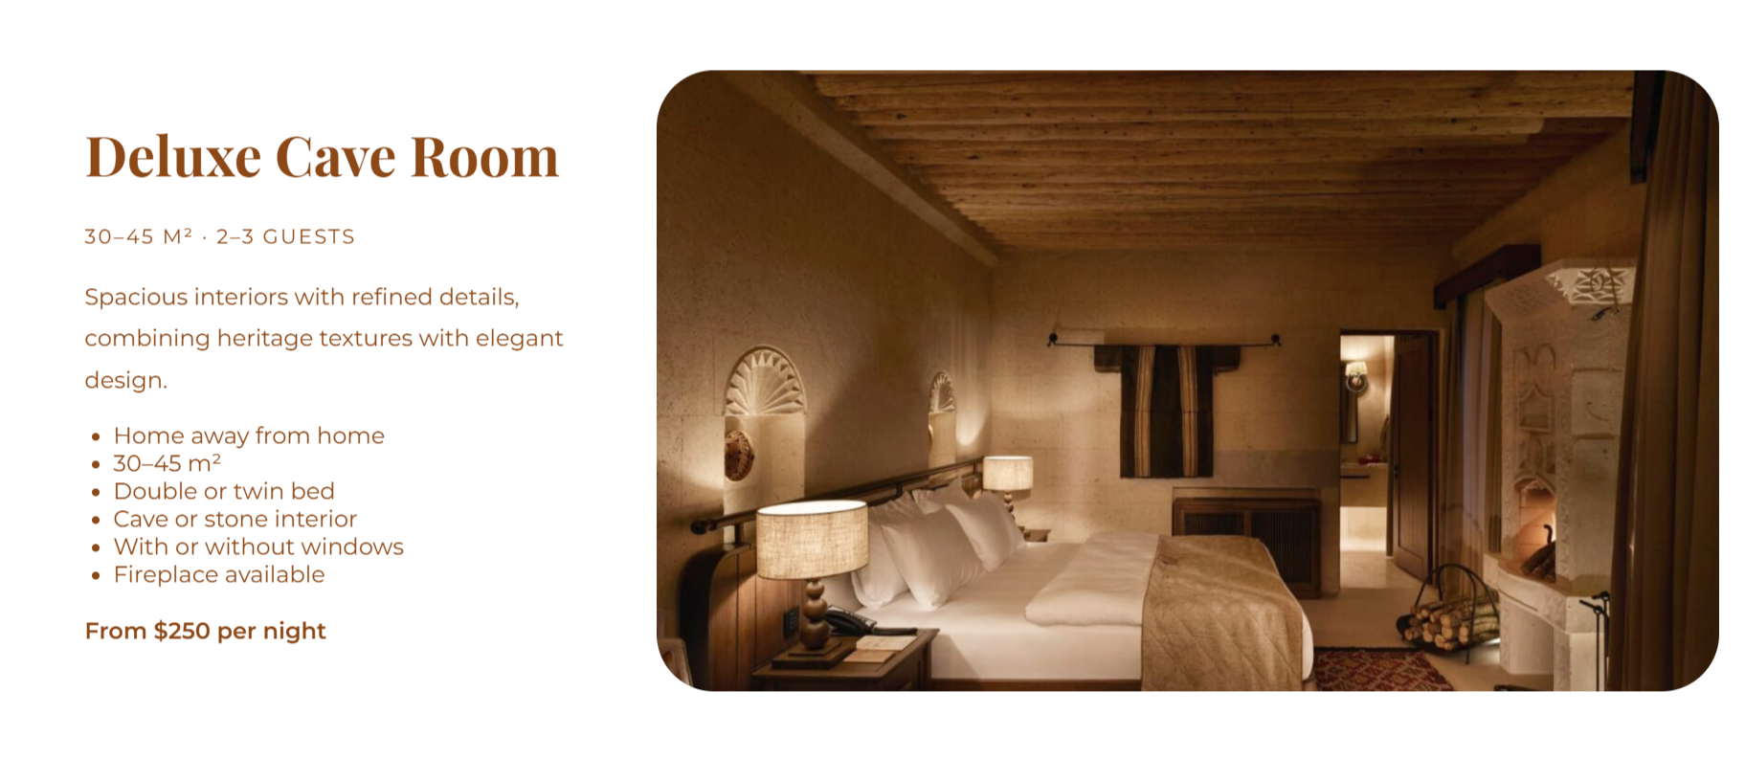
Figure 1.6: Example of rooms on website
Figure 1.7: Example of rooms on website

Slide 10
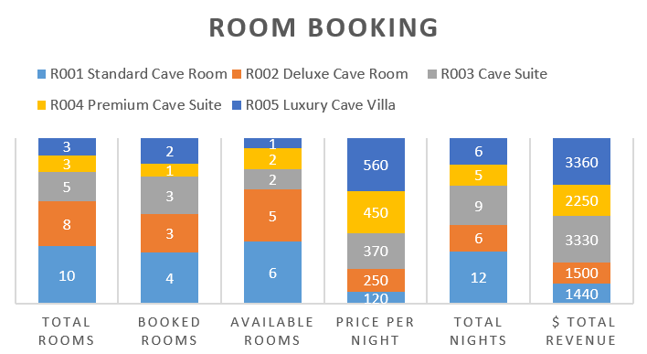
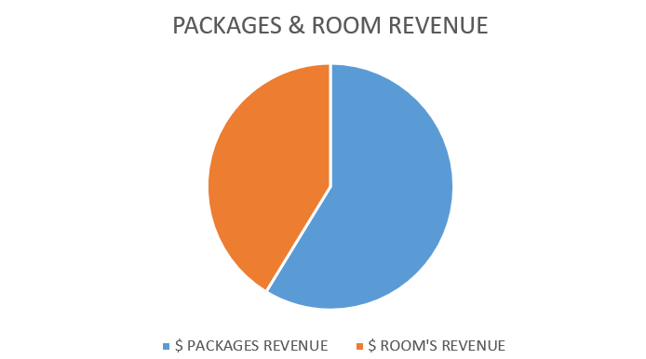
STATISTICAL DATA ON CAVE SUITES
Figure 1.8: Exported from Excel
Figure 1.9: Exported from Excel

Slide 11
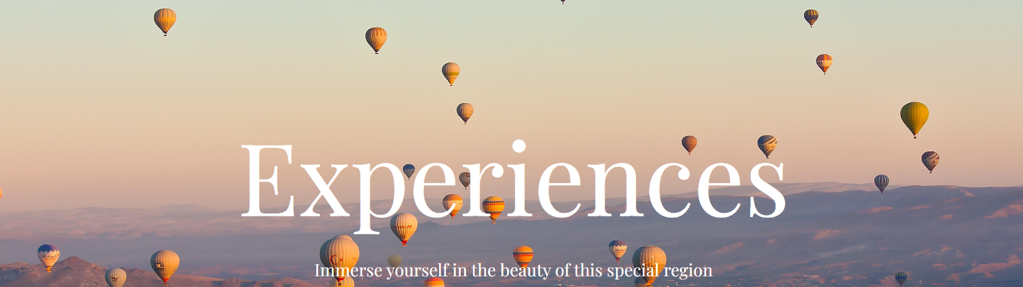

Slide 12
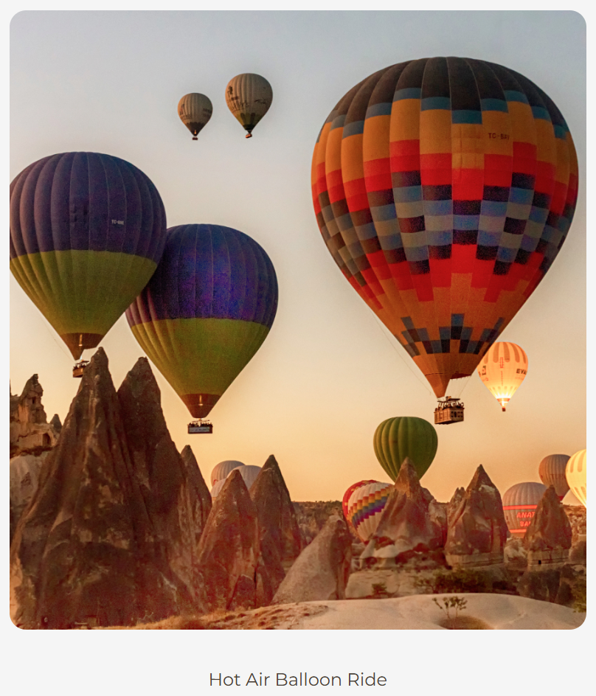
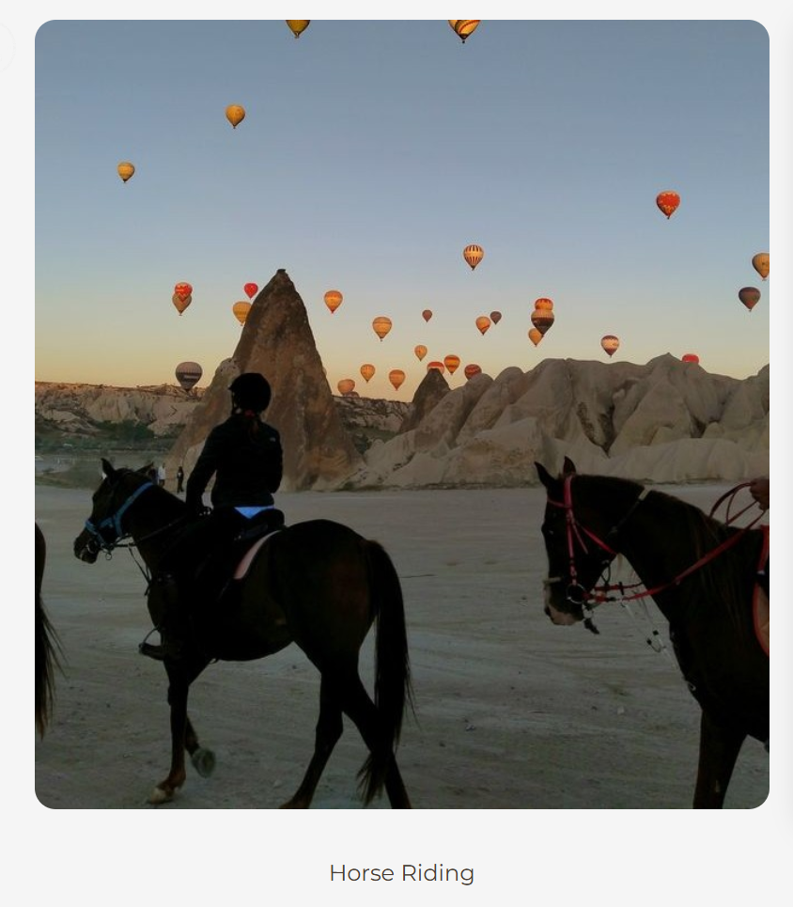
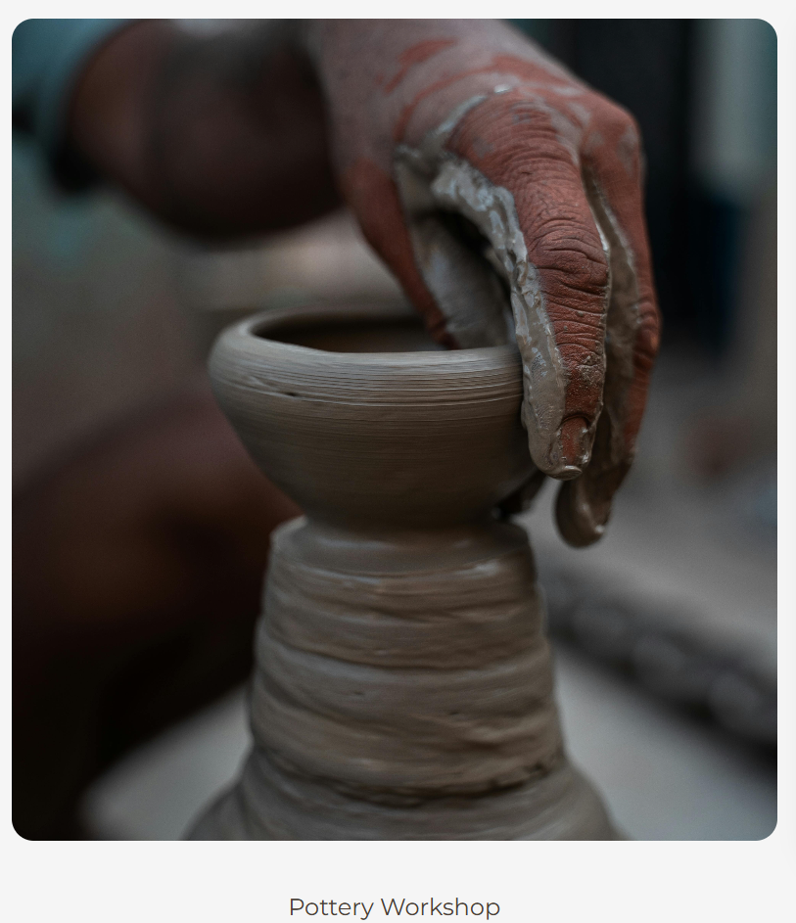
Figure 2.0
Figure 2.1
Figure 2.2

Slide 13
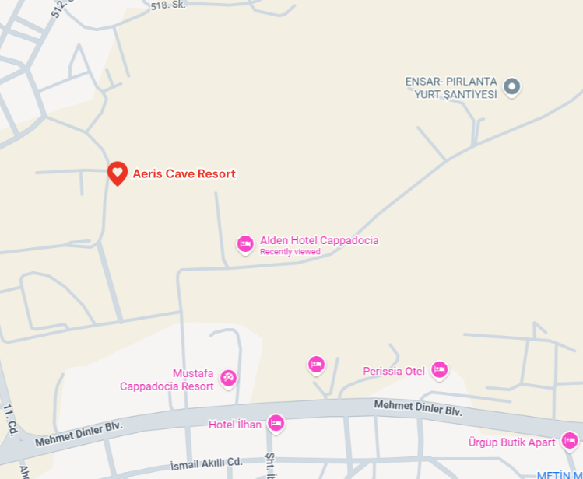
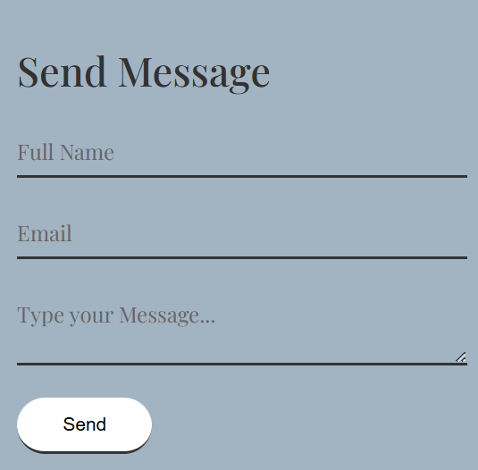
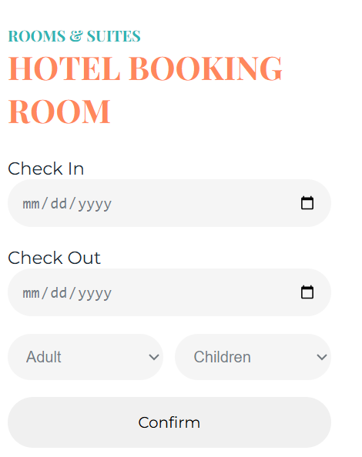
CONTACT/BOOKING
Figure 2.3 & 2.4 : Call to action buttons, and input requiring boxes.

Slide 14

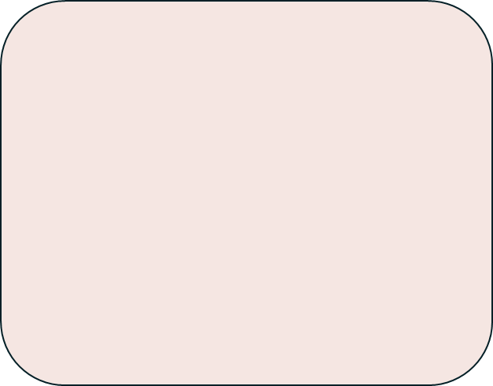
DESIGN DECISIONS
DESIGN DECISIONS
Font Colors:
Orange Primary Color
Orange Secondary Color (#8B4513)
Dark Text Color is used for readability and contrast, ensuring text is easy to read.
Light Text Color is applied on dark backgrounds to maintain clarity and visual balance.
Blue-1 Color as in the accent color.
Layout and Structure Decisions
The layout of the website was designed to be clean, structured, and user-friendly. Content is arranged in a clear visual hierarchy, with headings, subheadings, and body text properly separated. The layout is designed to be responsive, allowing the website to adapt smoothly to different screen sizes such as mobile, tablet, and desktop. A consistent layout structure is maintained across all pages to provide a uniform user experience.
Fonts Families:
Two complementary font families were chosen to create a balance between elegance and readability.
Playfair Display (Serif) is used for headings.
Montserrat (Sans-serif) is used for body text.

Slide 15

LINKS
DEMONSTRATIONAL VIDEO LINK
https://www.linkedin.com/posts/duaa-zehra-b112033a5_hello-everyone-i-would-like-to-share-a-demonstrationalactivity7414681951779074048V0h3?utm_source=share&utm_medium=member_desktop&rcm=ACoAAGMqAn0Bv1wcRphaWm3nebB_kh2d9IoyzMs
GITHUB REPOSITORY LINKS
https://hooriyasohail90-bot.github.io/Group-8-Aeris-Cave-Resort/index.html

Slide 16

REFLECTIONS/PROGRESSIONS
PROGRESSION STRATEGY:
Improve UI design with animations and effects
We can add more animation and effects to improve the UI design and to make the website more presentable to the user.
Add Additional Pages or Dynamic Content
Creating separate pages for booking, exploring rooms, and activities can improve website organization and enhance the user experience.
REFLECTIONS:
Gained practical experience in creating a complete website using HTML and CSS.
Improved understanding of layout design, color schemes, and typography for a tourism-based website.
Learned how to deploy and manage a live website using GitHub Pages.

